Slide 1
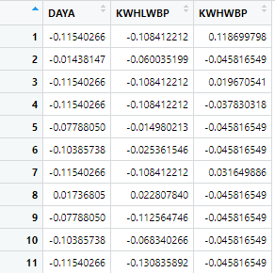
Scale Data

Slide 2
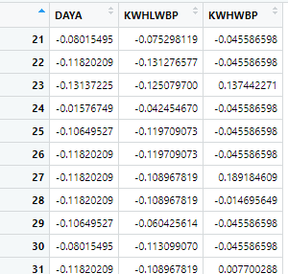
Scale Data

Slide 3
List of 9
$ cluster : int [1:200000] 1 1 1 1 1 1 1 1 1 1 ...
$ centers : num [1:2, 1:3] -0.017 39.0927 -0.016 36.784 -0.0161 ...
..- attr(*, "dimnames")=List of 2
.. ..$ : chr [1:2] "1" "2"
.. ..$ : chr [1:3] "DAYA" "KWHLWBP" "KWHWBP"
$ totss : num 6e+05
$ withinss : num [1:2] 87102 143105
$ tot.withinss: num 230207
$ betweenss : num 369790
$ size : int [1:2] 199913 87
$ iter : int 1
$ ifault : int 0
- attr(*, "class")= chr "kmeans"
Computing k-means clustering in R

Slide 4
K-means clustering with 2 clusters of sizes 199913, 87
Cluster means:
DAYA KWHLWBP KWHWBP
1 -0.01701271 -0.01600802 -0.01609205
2 39.09266180 36.78403009 36.97711770
Computing k-means clustering in R
Within cluster sum of squares by cluster:
[1] 87102.37 143104.85
(between_SS / total_SS = 61.6 %)

Slide 5
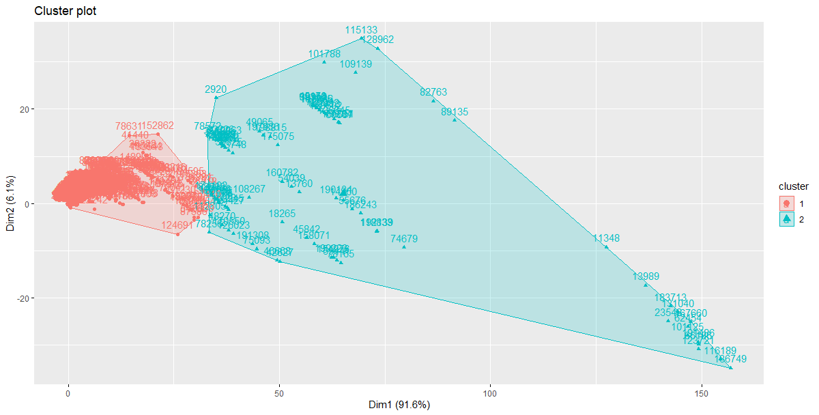

Slide 6
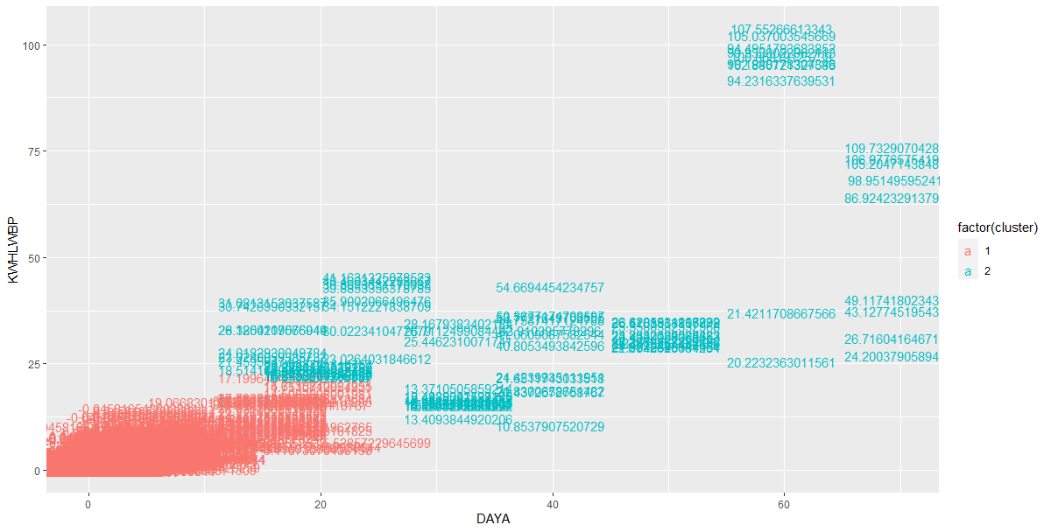

Slide 7
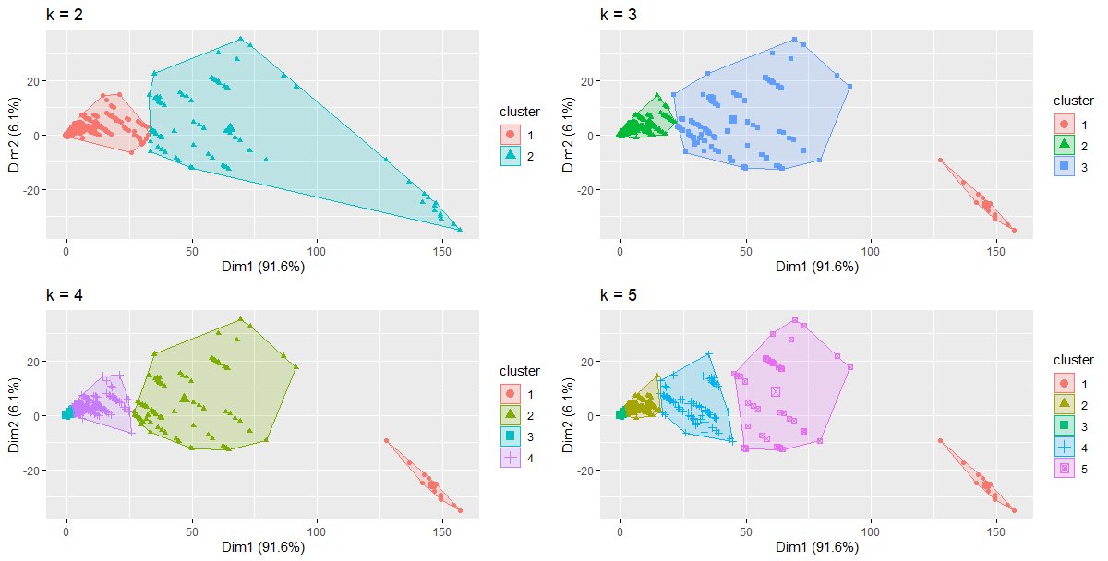

Slide 8
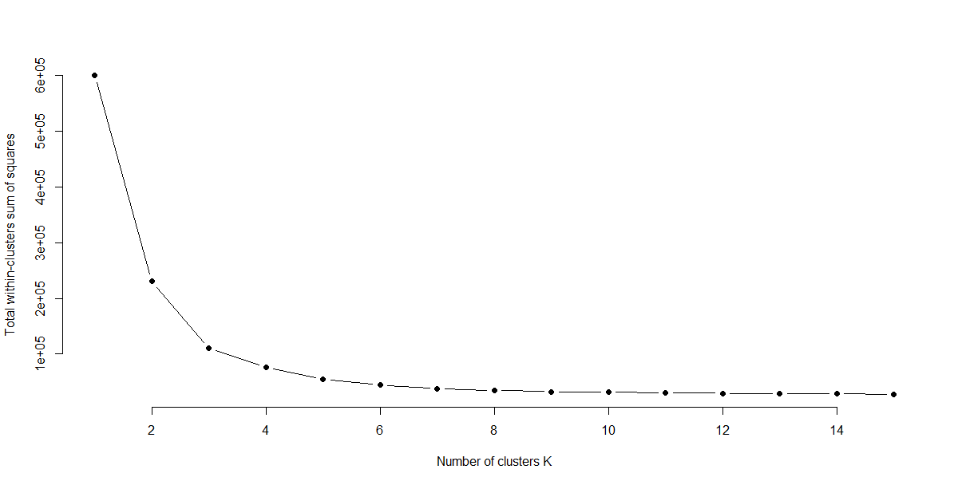

Slide 9
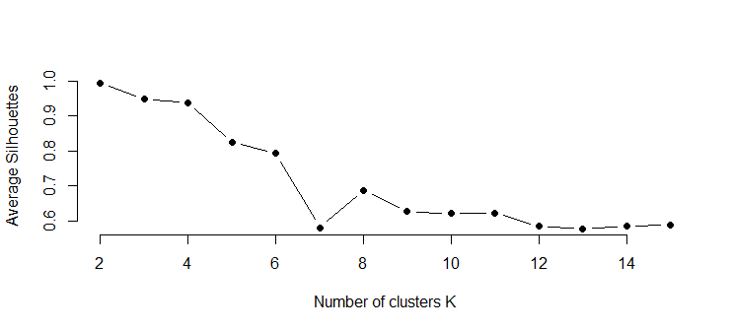

Slide 10
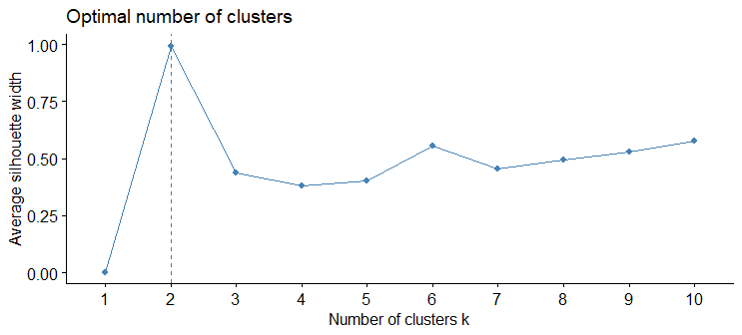

Slide 11
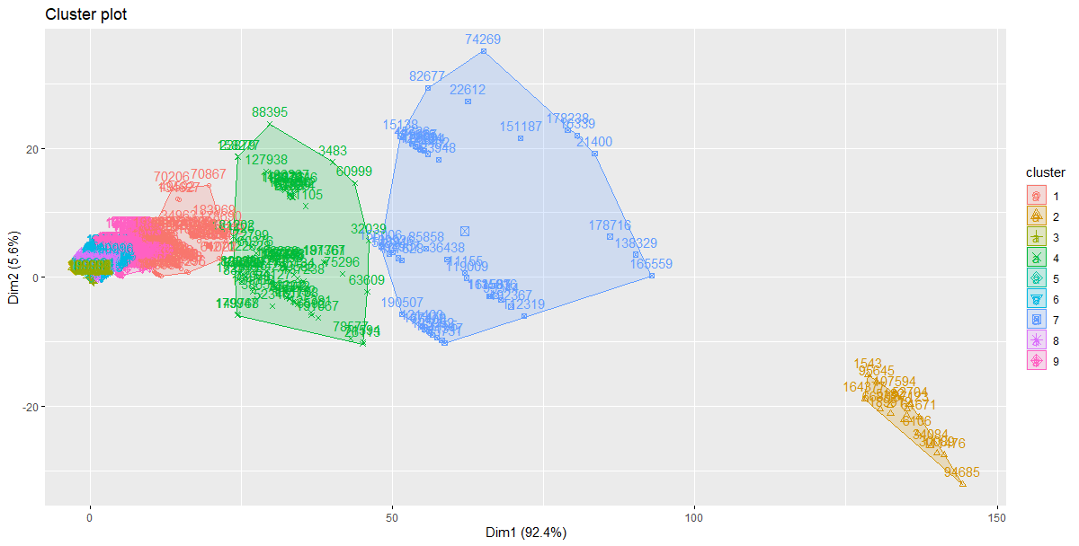

Slide 12
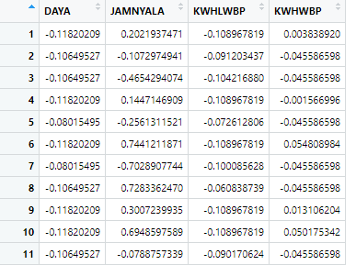
Scale Data

Slide 13
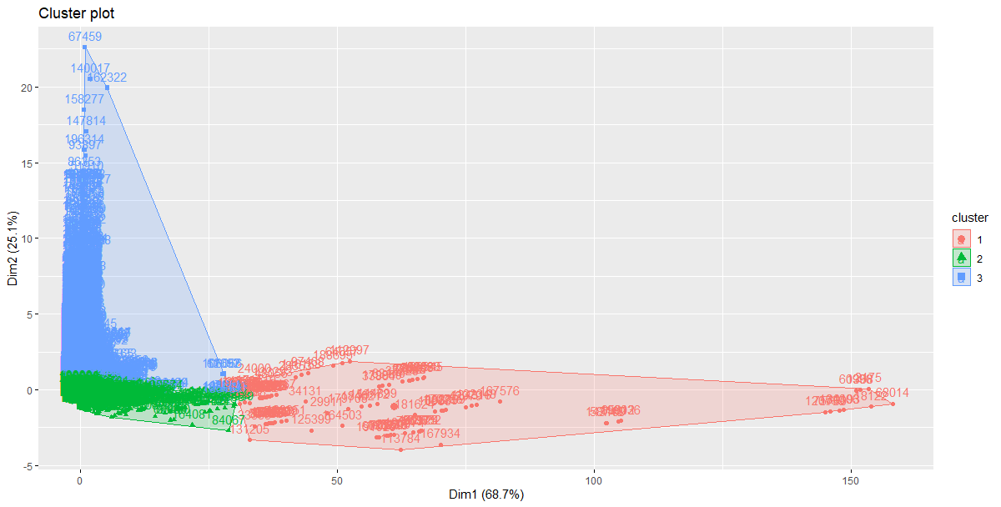

Slide 14
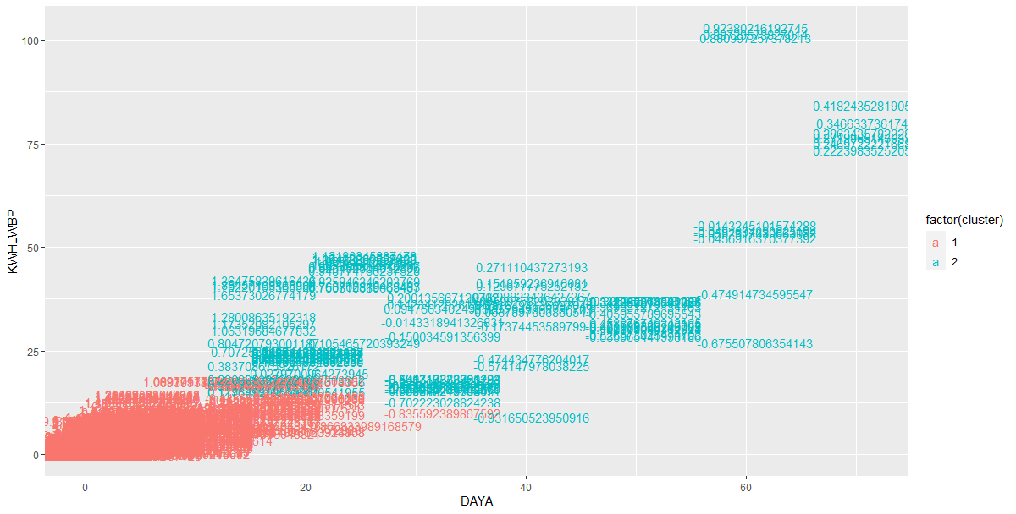

Slide 15
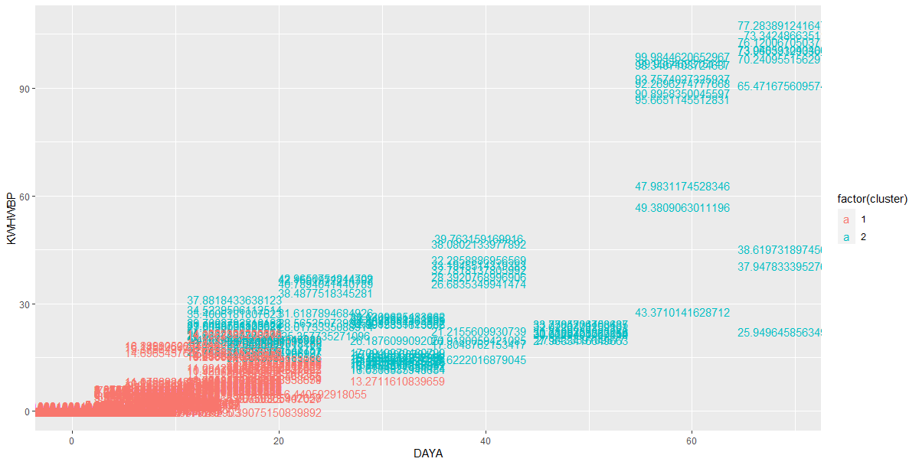

Slide 16
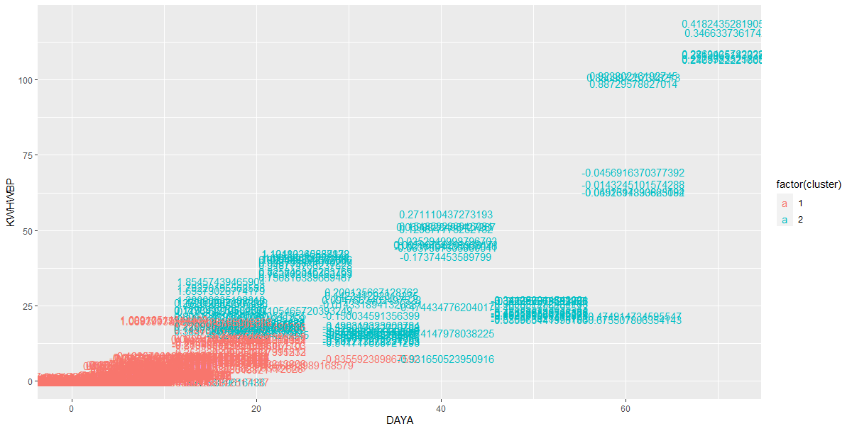

Slide 17
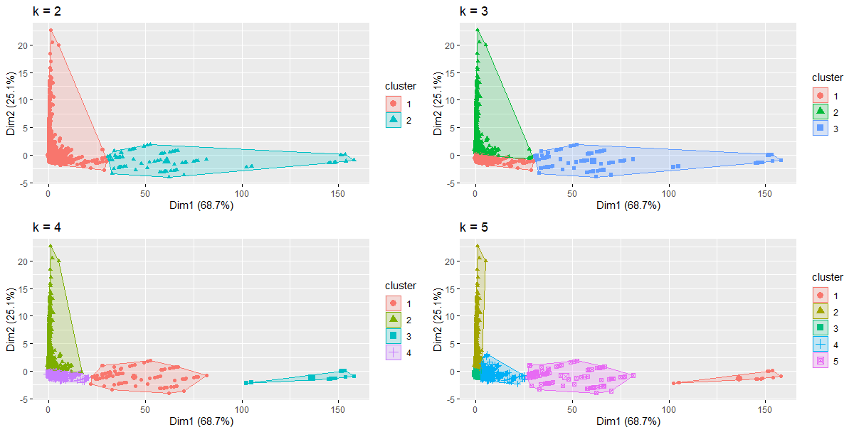

Slide 18
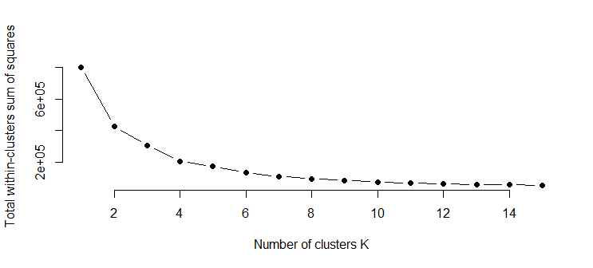

Slide 19


Slide 21
